Slide 1
Problem Statement
1) How can we measure the improvement of interoperability given data from CWIX?
2) How can this be communicated effectively to key stakeholders?
Critical success factors
1) Measure levels of interoperability.
2) Articulate effectively to key stakeholders.
Planned Dashboard Design
Main KPIs
1) Number of capabilities tested by operational domain.
Narrative: If the number of capabilities that are across multiple domains have increased this is a measure of improved interoperability.
2) Percent variation of test cases over CWIX exercise cycles.
Narrative: It is important to understand the success levels for each capability. This data can be used to drive appropriate actions depending upon the level of success.
3) NATO planned projects against Capabilities at CWIX.
Narrative: If x number of tests were not completed, it shows that the CWIX event itself was not organized sufficiently well enough to perform all tests or that tests themselves were too long. This results in delaying changes that could have otherwise been made which has an impact on how quickly better interoperability can be achieved.
High level dashboard
Detailed dashboard 1
Detailed dashboard 2
Process models

Slide 2
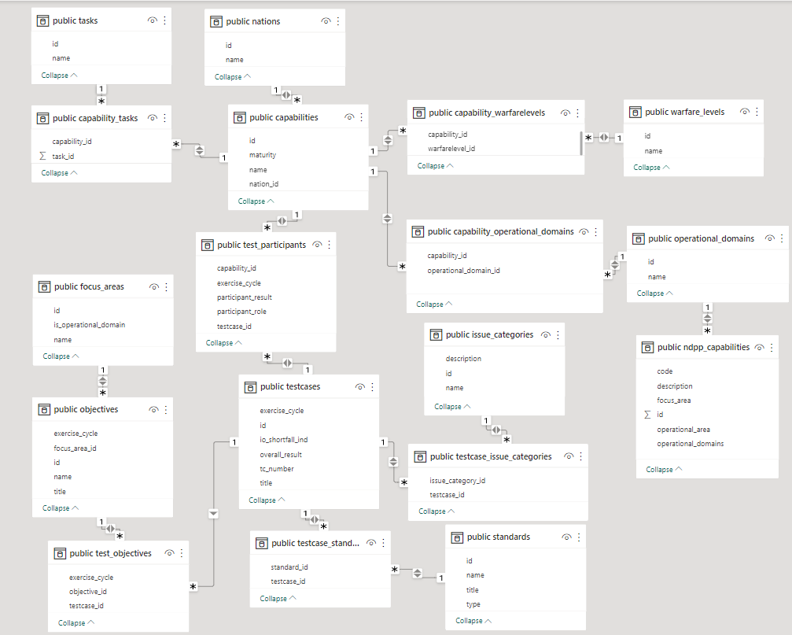
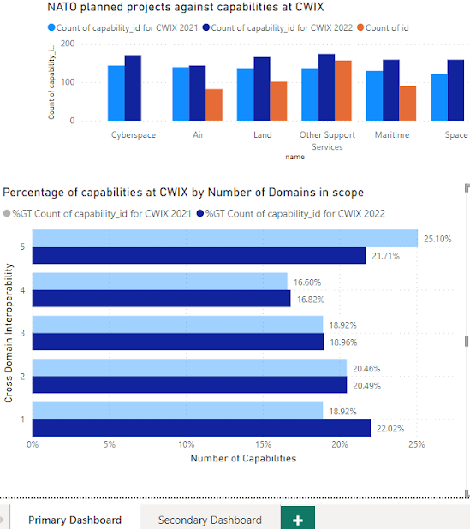
Data model
Notes:
We first created a data model in PowerBI using the reference data model that was given. In this way, the data tables are coherent throughout the process of creating all the metrics required for the dashboard. The data model can be utilized by NATO engineers so that they can easily explain the derivation of the KPIs to key stakeholders.

